Slide 1
Journal Club Presentation on A State of Art for Semantic Analysis of Natural Language Processing

Slide 2
Contents to be covered
Abstract
Introduction
Sentiment analysis
Semantic Analysis
Natural Language Processing
Ontology
Explanation of Example
Experimental results
Conclusion

Slide 3
A State of Art for Semantic Analysis of Natural Language Processing
Abstract—Semantic analysis is an essential feature of the Natural Language Processing (NLP) approach. It indicates, in the appropriate format, the context of a sentence or paragraph. Semantics is about language significance study. The vocabulary used conveys the importance of the subject because of the interrelationship between linguistic classes. In this article, semantic interpretation is carried out in the area of NLP.

Slide 4
INTRODUCTION
People access social media nowadays because of the intense tendency to share their viewpoints, and express their thoughts in a very casual fashion . It is important to consider the sentiment of the passage clearly . Research into word meanings is required. Most Semantic Analysis systems have been developed only in English and European languages [4].
Natural language is the most potent form of communication. In computer science and artificial intelligence, voice is how machines communicate with humans (natural language). There is a wide range of algorithms, including sorting, clustering, text mining, and so on .
NLP is this widespread nowadays and involves Chabot and text clustering. Word2vec is a technique for processing, it is templates are indeed used in areas beyond NLP, but it is not something to be embarrassed by .

Slide 5
Sentiment analysis
Sentiment analysis is a type of text classification where the subjectivity of the statements is essential. Opinion mining is the extraction of opinions from a large number of sources.
Sentiment analysis and opinion mining are interchangeable throughout this document . It collects opinion words through the NLP.
Sentiment analysis is described as detecting the sentiment of people about a specific topic and its features.
Opinion mining services are popular as people want to use others' advice to perform sensibly .

Slide 6
Semantic Analysis
In NLP, it is studied how to use NLP strategies to users' emotions and decide what users are expressing through them. Culture may affect this area differently, and This could be misinterpreted if it has taken too literally. “This new gadget is bad!” Although it was evident that the title alludes to the user’s dislike of the gadget, the title might endorse the gadget to a particular age group of the community .
The sentiment analysis will determine the time at which you express your opinion . To gather statements on a time axis can provide a better insight into peoples' feelings, Facebook and Twitter both provide challenges and opportunities for social movements. On the positive side, it allows people to express and express themselves freely. The records can be carefully observed for a specified time to study trends

Slide 7
Companies like Google, YouTube, and Amazon know how to customize the content for the customer's best interests. Depending on objective metrics such as social media likes, the number of consumers, and sales
It is challenging because of a: using different languages on one topic or blog, b: using non-standard words that cannot be found in a dictionary, and c: using emoji and symbols. These are questions relevant to both the emotion and sentiment analysis domain

Slide 8
Natural Language Processing
NLP is amongst the most complicated techniques in the world of artificial intelligence, text mining findings are inputs for NLP . NLP's capacity is that humans can speak words. It is the method of converting natural language output (spoken or written) into usable results.
NLP is an exciting challenge because it requires computer and human interaction to implement it. NLP is a field of computer studies concerned with studying and understanding the link between computers and the human language.

Slide 9
Example
In order to classify human emotions, the developed system includes a few major steps.
As the first step, the system collects Facebook comments on a particular business page, which is already published.
The next step is to preprocess the collected comments according to the common pre-processing procedures.
As the third step, the system processes a critical step which is called classification. To do that, a classification model is created using the machine learning algorithm; Naïve Bayes. Apart from that, the model is trained using an existing data set.
Finally, by comparing the keywords, the system classifies human emotions.
The classification process is done for every hour and generates the highest occurring emotion as the output. Likewise, this process is continued for each and every hour to classify the emotions.

Slide 10
Explanation of example
Data collection : The very first step of the research was to collect the data or comments of users from Facebook. To do that, Facebook Graph API has been used. Graph API, is an inbuilt API provided by Facebook for their developers. It is a primary way of getting data in and out from the Facebook platform
Pre-processing : Once the data have been collected through Graph API, next step was processing them according to the common pre- processing procedures. Those procedures include, eliminating English stop words, removing numbers, removing emoji’s, removing double quotations, slashes, underscores etc.
Classification : As the third step, the system has performed the critical process of classification. To do that, a classification model was created by using the machine learning algorithm Naïve Bayes. Naïve Bayes belongs to the probabilistic algorithm family and it uses Bayes’s Theorem to predict the text category.

Slide 11
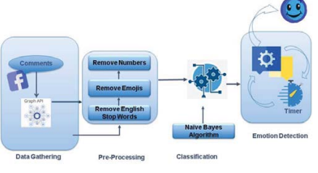
Naïve Bayes classifiers are extremely scalable and require a number of parameters in a learning problem. The model was trained using the existing data set. When creating the model, tags or the labels should be created as the first step. The research has used the emotion tags, including Happiness, Sadness, Anger and Surprise.
Emotion Detection :Finally, preprocessed data has been sent to the model via API and by comparing the key words, the model the classified human emotions as the output.

Slide 12
EXPERIMENTAL RESULTS
As the first step, the system has collected data via Facebook Graph API and comments have been returned as a Json object.
After that, the collected data has been assigned to a list which includes comments put up during the last hour
As the next step, preprocessing has been performed. The resulted values have been sent to the model as a byte array. Then, the model has classified the comments one by one and resulted in the output. Finally, among the resulted values, the system has returned the maximum emotion with an image, and all the results, including sadness, happiness, anger and surprise are displayed in a pie chart.

Slide 13
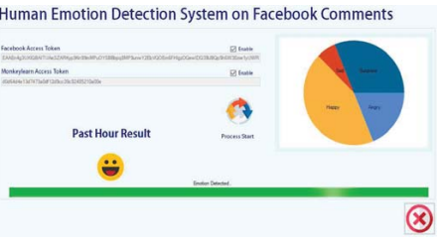
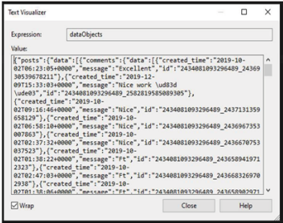
The following figure shows the most recent hourly data gathered via Facebook Graph API. It has returned the unprocessed comments and stored them inside a Json object. After that, the Json object has been deserialized and converted to a particular custom format.

Slide 14
CONCLUSION
Feelings or emotions play a critical role in human life and people express their feelings in everyday communications. Almost all the people in the world share their emotions on social media.
The purpose of the research is to identify emotions of online users by using Facebook comments. Selecting Facebook from numerous social media platforms, the research specifically focuses on Facebook comments written in the English language in order to narrow down the problem.

Slide 15
Thank you

Slide 16
Q & A

